Slide 1
Skills Bootcamp Classroom Rules
Be on time: Just like in a physical classroom, it's important to be punctual for your online class. Log in to the virtual classroom a few minutes before the class starts.
Turn Cameras on: In order to maximise your learning studies show that being able to see your peers and your tutor being able to see you can increase motivations and retention, therefore we ask to keep your cameras on.
Attend all classes: In order to be successful in your bootcamp studies you need to attend all live sessions, therefore you should prioritise and make time for these sessions.
Avoid distractions: Turn off your phone notifications, close any other unnecessary tabs, and focus solely on the class.
Participate actively: It's important to be an active participant in the class. Ask questions, answer questions, and participate in discussions.
Use proper language and tone: Use respectful language and tone when communicating with your classmates and instructor. Avoid using slang or inappropriate language.
Respect others' opinions: Be respectful of others' opinions, even if they differ from your own. Avoid making negative comments or attacking others.
Follow the instructor's guidelines: Follow the instructor's guidelines, such as submitting assignments on time.
Be polite: Be polite and respectful to everyone in the class, including the instructor, classmates, and guest speakers.
Dress appropriately: Even though you are not in a physical classroom, it's important to dress appropriately. Dress as if you were going to a face-to-face class.
Use appropriate technology: Ensure that you have the necessary equipment, such as a reliable internet connection, a microphone, and a webcam, and that they are in good working condition.

Slide 2
Software Developer Bootcamp
Unit 3 – Coding and Architecture
Week 7A

Slide 3
Objectives
Following this session, you should be able to:
Identify and Explain the Core Principles of Interface Design
Evaluate Existing User Interfaces Using Established Criteria
Design a Mock Interface Incorporating the Principles Learnt
Understand logical expressions

Slide 4
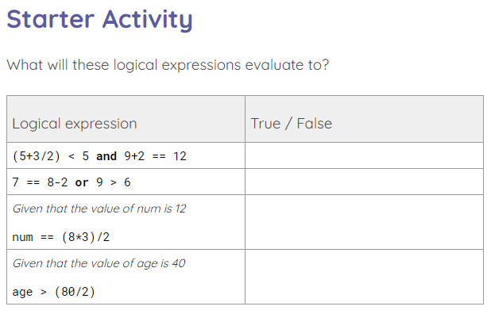
What will these logical expressions evaluate to?
Use the starter activity worksheet to evaluate the logical expressions.
Notes:
A0 Worksheet – Starter activity

Slide 5
Answers
(5+3/2) < 5 and 9+2 == 12
False

Slide 6
Answers
7 == 8-2 or 9 > 6
True

Slide 7
Answers
Given that the value of num is 12
num == (8*3)/2
True

Slide 8
Answers
Given that the value of age is 40
age > (80/2)
False

Slide 9
Core Principles of Interface Design

Slide 10
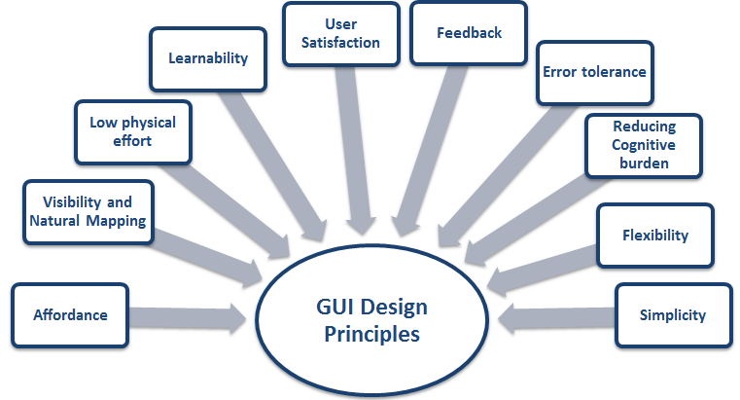
Core Principles of Interface Design
Usability
Consistency
Feedback
Flexibility
Accessibility
Learnability
Aesthetics
Security

Slide 11
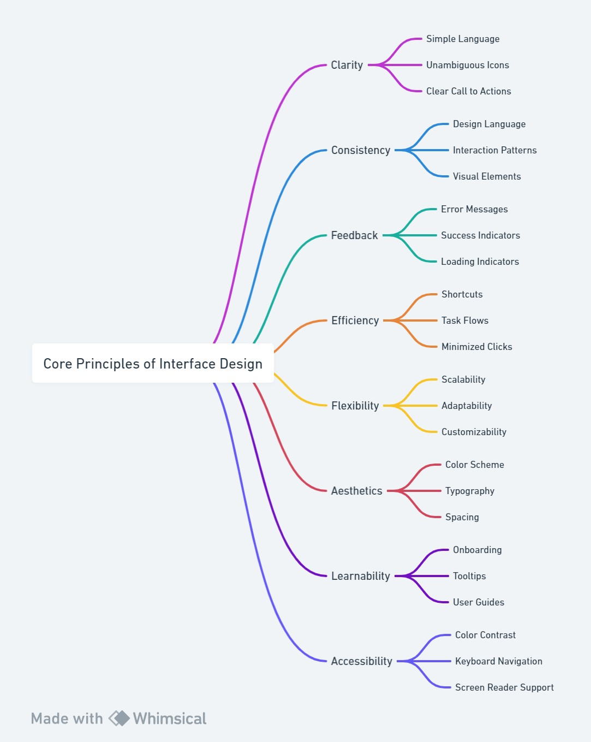
Core Principles of Interface Design

Slide 12

Usability
Usability is the most important principle of interface design. It is the measure of how easy it is for users to interact with the interface and complete their tasks.
The interface should be intuitive and easy to use, with clear instructions and feedback for the user.

Slide 13

Consistency
Consistency is important for creating a familiar experience for users. The interface should use the same language, design elements, and navigation throughout.
This will help users to quickly understand how to use the interface and make it easier to complete tasks.

Slide 14

Feedback
Feedback is essential for providing clear communication between the user and the interface. The interface should provide feedback when an action is taken, such as a confirmation message or a progress bar.
This will help the user to understand what is happening and if their action was successful.

Slide 15

Flexibility
Flexibility is important for adapting to user needs. The interface should be able to accommodate different user preferences and allow users to customize their experience.
This will help users to feel in control of their experience and make it easier to complete tasks.

Slide 16

Accessibility
Accessibility is essential for making the interface available to all users. The interface should be designed to be accessible to users with disabilities, such as providing alternative text for images or using high contrast colors.
This will help to ensure that all users can access and use the interface.

Slide 17

Learnability
Learnability is important for making it easy to learn how to use the interface. The interface should be designed to be intuitive and easy to understand, with clear instructions and feedback for the user.
This will help users to quickly learn how to use the interface and make it easier to complete tasks.

Slide 18

Aesthetics
Aesthetics is important for creating an appealing design. The interface should be visually appealing and use colors, fonts, and images to create a pleasant experience for the user.
This will help to create an enjoyable experience for the user and make it easier to use the interface.

Slide 19

Security
Security is essential for protecting user data. The interface should be designed to protect user data from unauthorized access and use encryption to protect data in transit.
This will help to ensure that user data is secure and protected from malicious actors.

Slide 20

Conclusion
The core principles of interface design are usability, consistency, feedback, flexibility, accessibility, learnability, aesthetics, and security.
By following these principles, designers can create an interface that is easy to use, visually appealing, and secure, resulting in a better user experience.

Slide 21
Evaluate User Interfaces Using Core Principles

Slide 22
What is User Interface Evaluation?
Definition of User Interface Evaluation: User interface evaluation is the process of assessing a digital product's usability, functionality, and overall user experience to identify areas for improvement.
Purpose of User Interface Evaluation: The primary purpose of user interface evaluation is to ensure that the design meets user needs and expectations, thereby enhancing user satisfaction and engagement.
Types of User Interface Evaluation: Common types of user interface evaluation include heuristic evaluation, user testing, and A/B testing, each offering different insights into user interaction and design effectiveness.

Slide 23

Establishing Evaluation Criteria
Importance of Establishing Criteria: Establishing criteria is crucial for making objective evaluations and informed decisions, ensuring consistency and fairness across assessments.
Types of Criteria to Consider: The criteria to consider may include qualitative factors like usability and design, as well as quantitative metrics like load time and user engagement rates.
Examples of Criteria to Consider: Examples of criteria to consider could be user-friendliness, aesthetic appeal, functionality, and accessibility, among others.

Slide 24

Evaluating User Interfaces
Process of Evaluating User Interfaces: The process of evaluating user interfaces involves assessing various design elements such as layout, navigation, and accessibility to ensure an optimal user experience.
Tools and Techniques for Evaluation: Tools like heatmaps, A/B testing, and user surveys are commonly employed techniques for evaluating the effectiveness of a user interface.
Benefits of Evaluating User Interfaces: Evaluating user interfaces helps in identifying usability issues, improving user satisfaction, and ultimately increasing the overall effectiveness of the digital product.

Slide 25

Usability Testing
Definition of Usability Testing: Usability testing is the process of evaluating a product or website by testing it on users to ensure that it's easy and intuitive to use.
Purpose of Usability Testing: The primary purpose of usability testing is to identify usability issues and gather insights to improve the user experience.
Types of Usability Testing: Common types of usability testing include formative and summative testing, remote and in-person testing, and moderated and unmoderated testing.

Slide 26

Heuristic Evaluation
Definition of Heuristic Evaluation: Heuristic evaluation is a usability inspection method where experts evaluate a user interface based on established usability principles, known as heuristics.
Purpose of Heuristic Evaluation: The primary purpose of heuristic evaluation is to identify usability issues in a user interface design to address them before the final product is released.
Types of Heuristic Evaluation: Heuristic evaluations can be general, focusing on broad usability principles, or domain-specific, targeting criteria relevant to a particular industry or user group.

Slide 27

Analytics and Metrics
Definition of Analytics and Metrics: Analytics and metrics refer to the systematic computational analysis of data and the quantifiable measures used to track, assess, and report on the performance of various aspects of a business or system.
Purpose of Analytics and Metrics: The primary purpose of analytics and metrics is to provide actionable insights for informed decision-making, enabling organisations to optimise performance, enhance customer experience, and achieve strategic goals.
Types of Analytics and Metrics: Analytics and metrics can be categorised into various types, such as descriptive, predictive, and prescriptive analytics, as well as key performance indicators (KPIs), customer metrics, and financial metrics, among others.

Slide 28

User Surveys
Definition of User Surveys: User surveys are structured questionnaires designed to gather feedback from users about their experiences and perceptions of a product, service, or system.
Purpose of User Surveys: The primary purpose of user surveys is to collect data that can be used to improve user experience, identify pain points, and make data-driven decisions.
Types of User Surveys: User surveys can be categorised into various types such as satisfaction surveys, usability surveys, and post-interaction surveys, each serving a specific objective in the user experience design process.

Slide 29

Benefits of Evaluating User Interfaces
Improved user experience leads to higher customer satisfaction and loyalty, enhancing the overall success of a digital platform.
Increased user engagement is a key indicator of a well-designed interface, often resulting in higher conversion rates and customer retention.
Reduced development costs allow companies to allocate resources more efficiently, enabling faster innovation and market responsiveness.

Slide 30

Conclusion
Summary of user interface evaluation
Benefits of evaluating user interfaces
Importance of establishing criteria

Slide 31
How to Design an Interface Incorporating the Principles Learnt

Slide 32

Design Principles
Understand user needs
Create a consistent design
Make the interface intuitive
Provide feedback to the user
Make the interface accessible

Slide 33

Design Process
Gather user requirements
Create a wireframe
Design the interface
Test the interface
Implement the interface

Slide 34

Design Elements
Layout
Typography
Color
Icons
Images

Slide 35
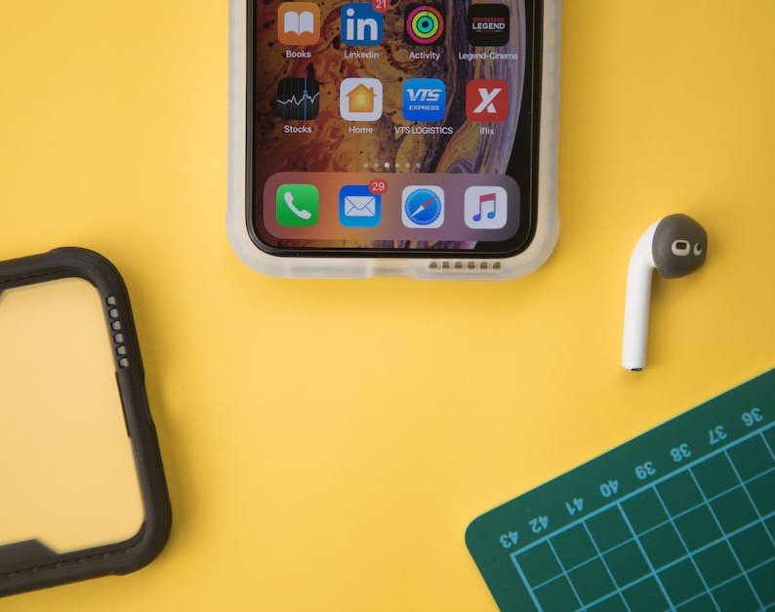
Layout
Organise content in a logical manner
Use whitespace to separate content
Make sure the interface is responsive

Slide 36

Typography
Choose a font that is easy to read
Use font size and weight to emphasize important elements
Use color to draw attention to important elements

Slide 37
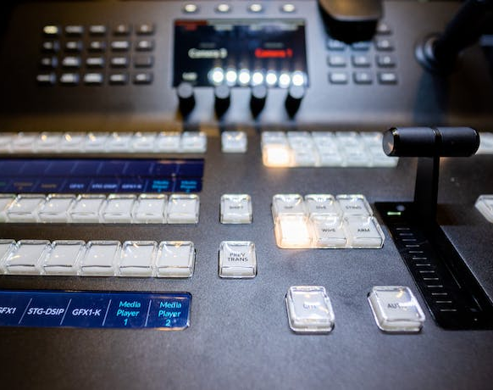
Color
Choose colors that are easy to read
Use color to draw attention to important elements
Use color to create a consistent design

Slide 38
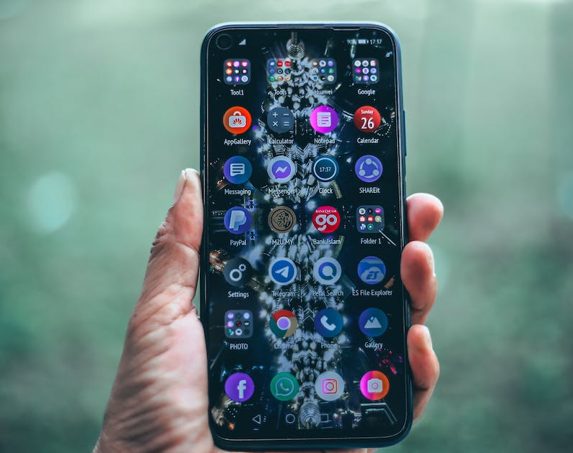
Icons
Choose icons that are easy to understand
Use icons to draw attention to important elements
Use icons to create a consistent design

Slide 39

Images
Choose images that are easy to understand
Use images to draw attention to important elements
Use images to create a consistent design

Slide 40
Conclusion
Designing a user-friendly interface requires understanding user needs
Creating a consistent design is essential for a successful interface
Using the right design elements can make the interface intuitive and accessible

Slide 41
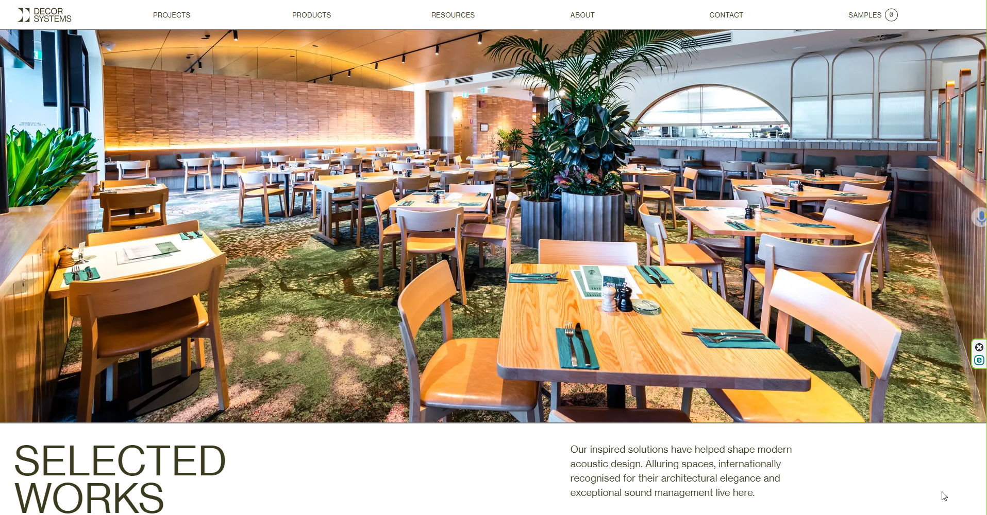
Case Study - Core Principles of Interface Design in Decor Systems' Website

Slide 42
Case Study - Core Principles of Interface Design in Decor Systems' Website
In this case study, we'll be diving into a case study that evaluates the user interface design of Decor Systems, an Australian architectural firm. Before we delve into the evaluation, let's first understand the core principles of interface design that are crucial for any website: https://decorsystems.com.au/
Simplicity: The design should be simple and uncluttered.
Consistency: The design elements should be consistent across all pages.
Navigation: Easy navigation is key to a good user experience.
Responsiveness: The design should adapt to various screen sizes.
Accessibility: The website should be accessible to all, including those with disabilities.

Slide 43
Case Study - Core Principles of Interface Design in Decor Systems' Website
We will now evaluate Decor Systems' website based on the core principles in the previous slide.
Simplicity: The website uses a clean layout with detailed images and on-scroll animations.
Consistency: The use of space and design elements is consistent throughout.
Navigation: The site navigation employs fly-out menus, making it user-friendly.
Responsiveness: The website is mobile-responsive, adapting well to various screen sizes.
Accessibility: While the website is visually appealing, it could improve its accessibility features.
Overall, Decor Systems does a commendable job in most areas but has room for improvement in accessibility.

Slide 44
Case Study - Core Principles of Interface Design in Decor Systems' Website
Now, we will discuss some proposed improvements for Decor Systems' website.
Simplicity: Maintain the clean layout but streamline the animations to load faster.
Consistency: No changes are needed here; the current design is highly consistent.
Navigation: Introduce a search function to enhance user navigation.
Responsiveness: The current design is responsive and doesn't require changes.
Accessibility: Introduce alt-text for images and improve keyboard navigation.
By incorporating these changes, Decor Systems can elevate their user interface to the next level.

Slide 45
15-Minute Group Activity: Evaluate BBC Web Site
This activity is based on Evaluating the BBC Website: https://www.bbc.com/
Objectives:
Evaluate Existing User Interfaces Using Established Criteria
Introduction:
The BBC website is a well-known platform offering news, entertainment, and educational content. It serves as an excellent example for studying interface design due to its wide reach and diverse user base.

Slide 46
15-Minute Group Activity: Evaluate BBC Web Site
Instructions:
Assign Roles: In each group, different roles will be assigned—Designer, Evaluator, and Recorder.
Brainstorm: Spend 5 minutes brainstorming ideas for improving a specific section of the BBC website (e.g., the homepage, news section, etc.).
Evaluate: Write down how your suggestions adhere to each core principle.
Presentation: Each group will present their findings

Slide 47
15-Minute Group Activity: Evaluate BBC Web Site Discussion
Evaluating the BBC site using the Core Principles of Interface Design:
Simplicity: The BBC website uses a clean and straightforward design.
Consistency: The layout and design elements are consistent across different sections.
Navigation: The website features a top navigation bar and a search function.
Responsiveness: The website adapts well to various screen sizes.
Accessibility: The BBC website includes features like subtitles and alternative text for images.

Slide 48
Objectives
Now, you should be able to:
Identify and Explain the Core Principles of Interface Design
Evaluate Existing User Interfaces Using Established Criteria
Design a Mock Interface Incorporating the Principles Learnt
Understand logical expressions

Slide 49

Questions?

Slide 50
Thank You

